Slide 1
Telco Customer Churn
Daniel Eckman, Cole Compton, Melanie Vogt

Slide 2
Problem Statement
Our goal in this project is the creation of a model which predicts whether a customer will continue doing business with a certain company or not, according to the factors in the data like their demographics or monthly charge. We will then make note of what specific features contribute most to a customer's decision to leave, which may reveal avenues for improving the company's efficiency and reduces customer churn.

Slide 3
Dataset
IBM Telco Customer Churn Dataset (Kaggle)
~7,043 customers records
33 columns
Include:
Demographics (gender, senior citizen)
Account Information (contract type, tenure)
Billing (monthly charges, payment method)
Target Variable: Churn_Value renamed to /churn
Original churn rate 26.54%

Slide 4
MySQL + Workflow
Loaded Excel data into a MySQL database
Created database: telco_churn_db
Created table: customer_churn
Read the data from MySQL into pandas for preprocessing and modeling

Slide 5
Data Preprocessing
Removed irrelevant and leakage features
CustomerID, Count Country, State, City, Zip_Code
Lat_Long, Latitude, Longitude
Churn_Label, Churn_Score, CLTV, Churn_Reason
Converted Total_Charges to numeric
Filed missing Total_Charges values with the median
One_hot encoded categorical variables
Split data:
80% training / 20% testing (stratified)

Slide 6
Feature Engineering
Created 6 new features:
Avg_Monthly_Charge
Tenure_Group
Total_Services
Has_Services
Senior_With_Dependents
Paperless_Auto_Pay

Slide 7
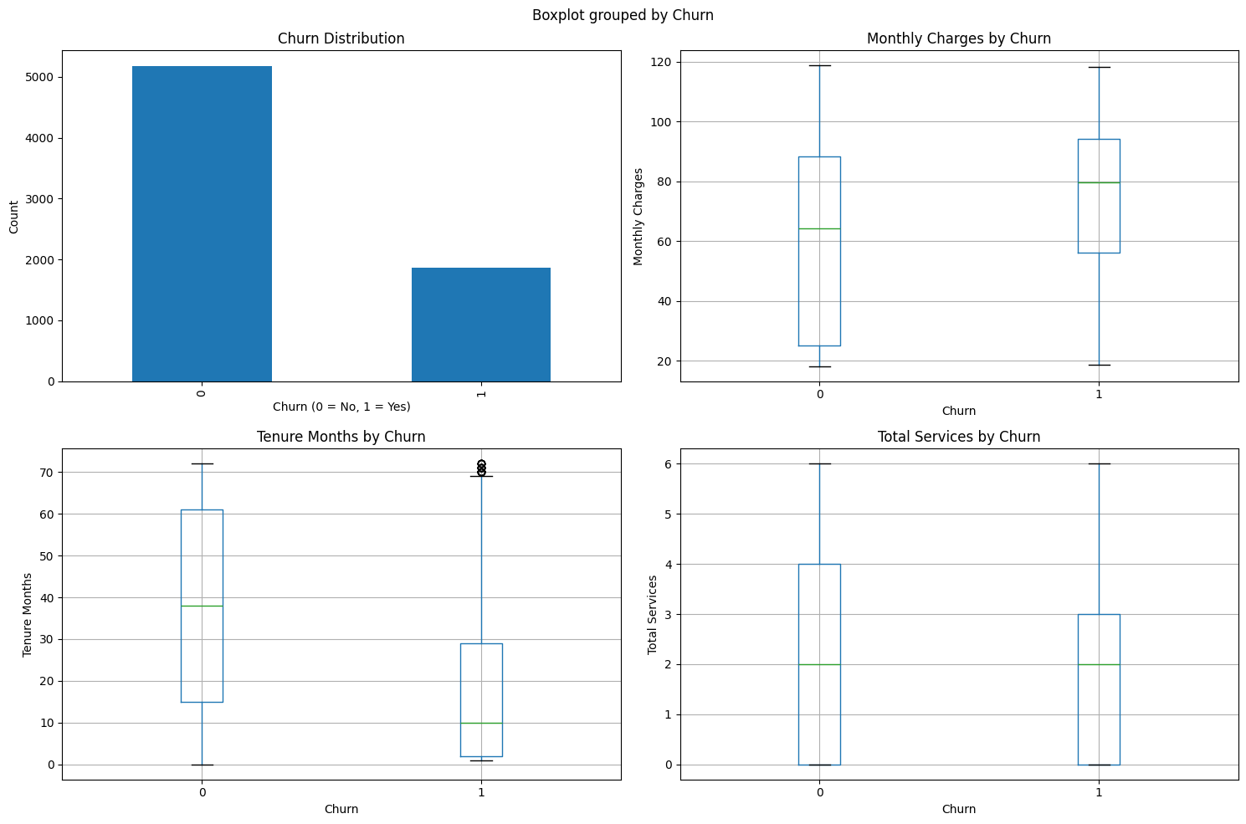

Slide 8
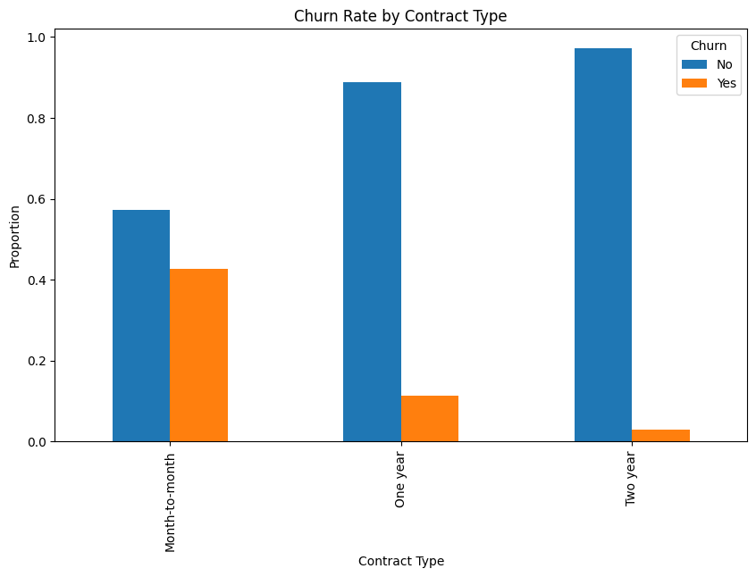

Slide 9
Exploratory Data Analysis
Churners tend to have a higher monthly charges
Churners tend to have a shorter tenure
Contract type appears strongly related to churn

Slide 10
Handling Class Imbalance
Training set before SMOTE:
5,634 rows
Churn: 1,495
Non_churn: 4,139
After SMOTE:
7,450 rows
Churn rate increased to 44.44%

Slide 11
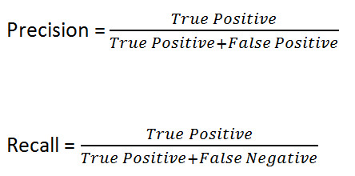
Models Used
Logistic Regression
Random Forest
Hyperparameter tuning with cross_validation
Metrics:
Accuracy
Precision
Recall
F1-score
Confusion Matrix
remember:

Slide 12
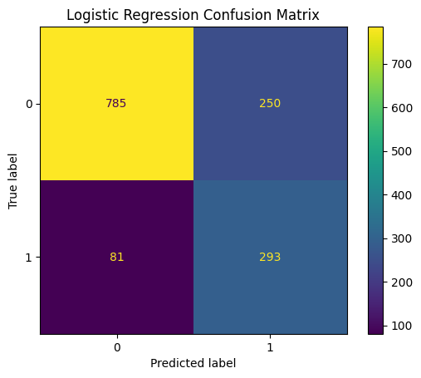
Logistic Regression Results
Accuracy: 0.7651
Precision: 0.5396
Recall: 0.7834
F1 Score: 0.6390
Best parameters:
C=0.1
penalty=’l2’
solver=’liblinear’
Best CV F1: 0.7836

Slide 13
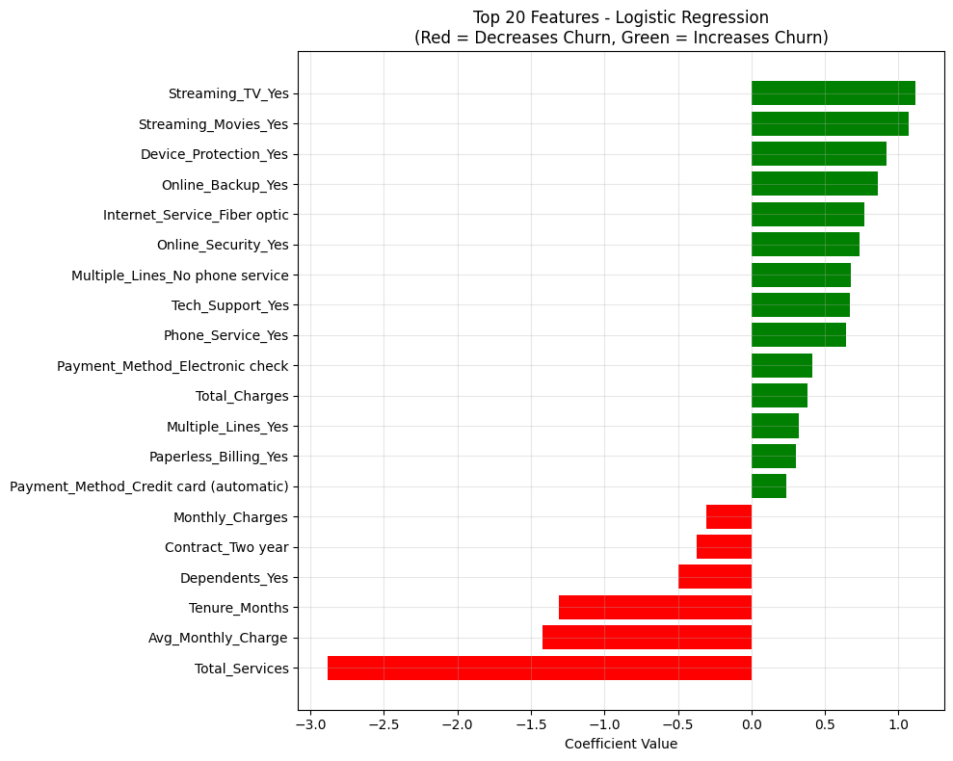

Slide 14
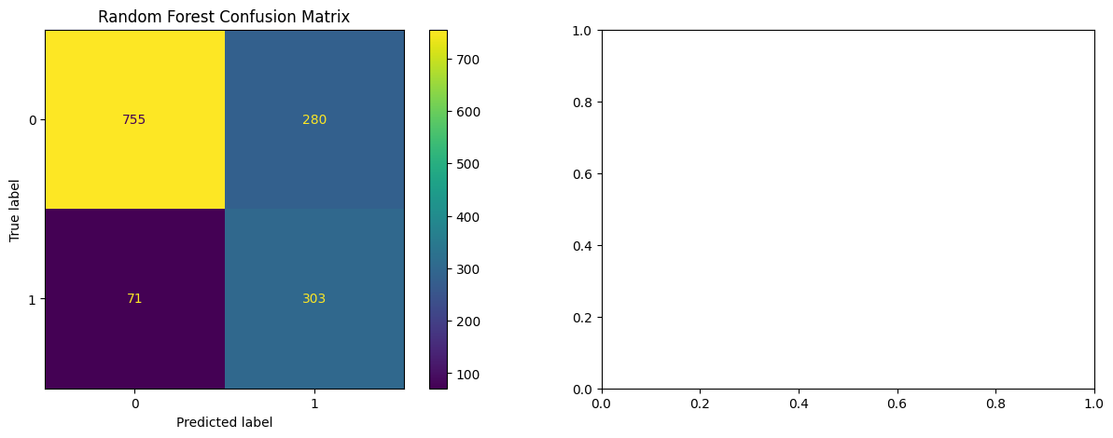
Random Forest Results
Accuracy: 0.7509
Precision: 0.5197
Recall: 0.8102
F1 Score: 0.6332
Best Parameters:
n_estimators=200
min_samples_split=2
min_samples_leaf=2
max_features=’log2’
max_depth=None
Mean CV F1: 0.8148

Slide 15
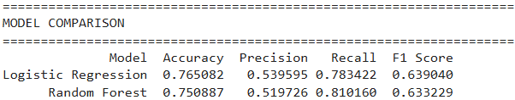
Model Comparison
Selected model: Random Forest, due to stronger recall and cross-validation F1

Slide 16
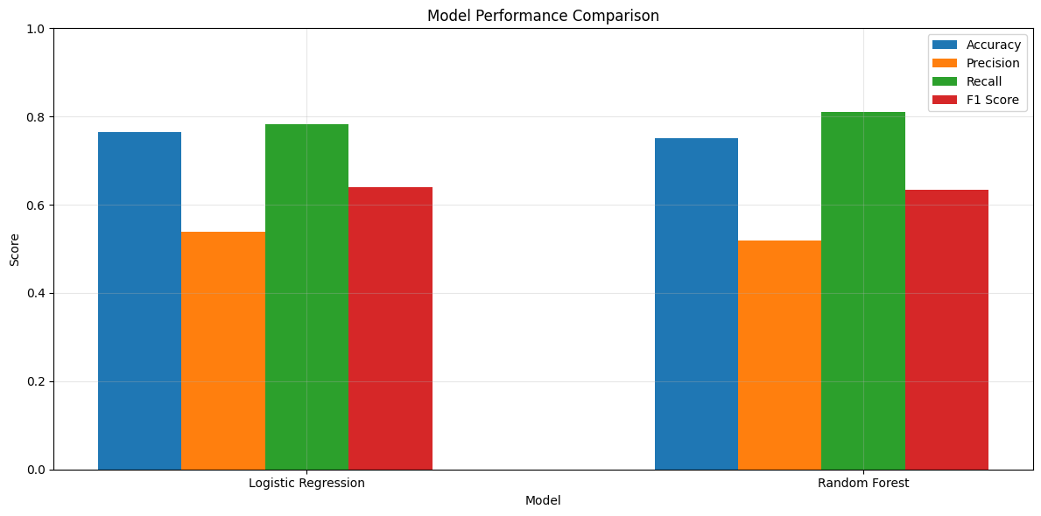

Slide 17
Key Insights
Shorter tenure is associated with churn
Higher monthly charges are associated with churn
Contract type is a major churn indicator
Service-related features also contribute to churn risk

Slide 18
Conclusion
Successfully built a churn prediction pipeline
Used MySQL, preprocessing, feature engineering, SMOTE, and model tuning
Compared Logistic Regression and Random Forest
Random Forest selected as best model
Findings can support customer retention strategies

